Slide 1

Honest AI: Challenges, Opportunities and Reckonings with Generative AI
Dr Cameron Edmond
Notes:
(2 minutes)
-Introduction to the topic
-Fact I am neither “pro” nor “anti” Generative AI, but have many different feelings.
-The field is rapidly evolving, so things come in and out of fashion and relevance.

Slide 2

Your discipline and AI
Think about:
What parts of your practice are you replacing with AI?
Are these the same as the ones you allow your students to use AI for? Why/why not?
Notes:
(1 minute) -Lead in for the workshop.

Slide 3
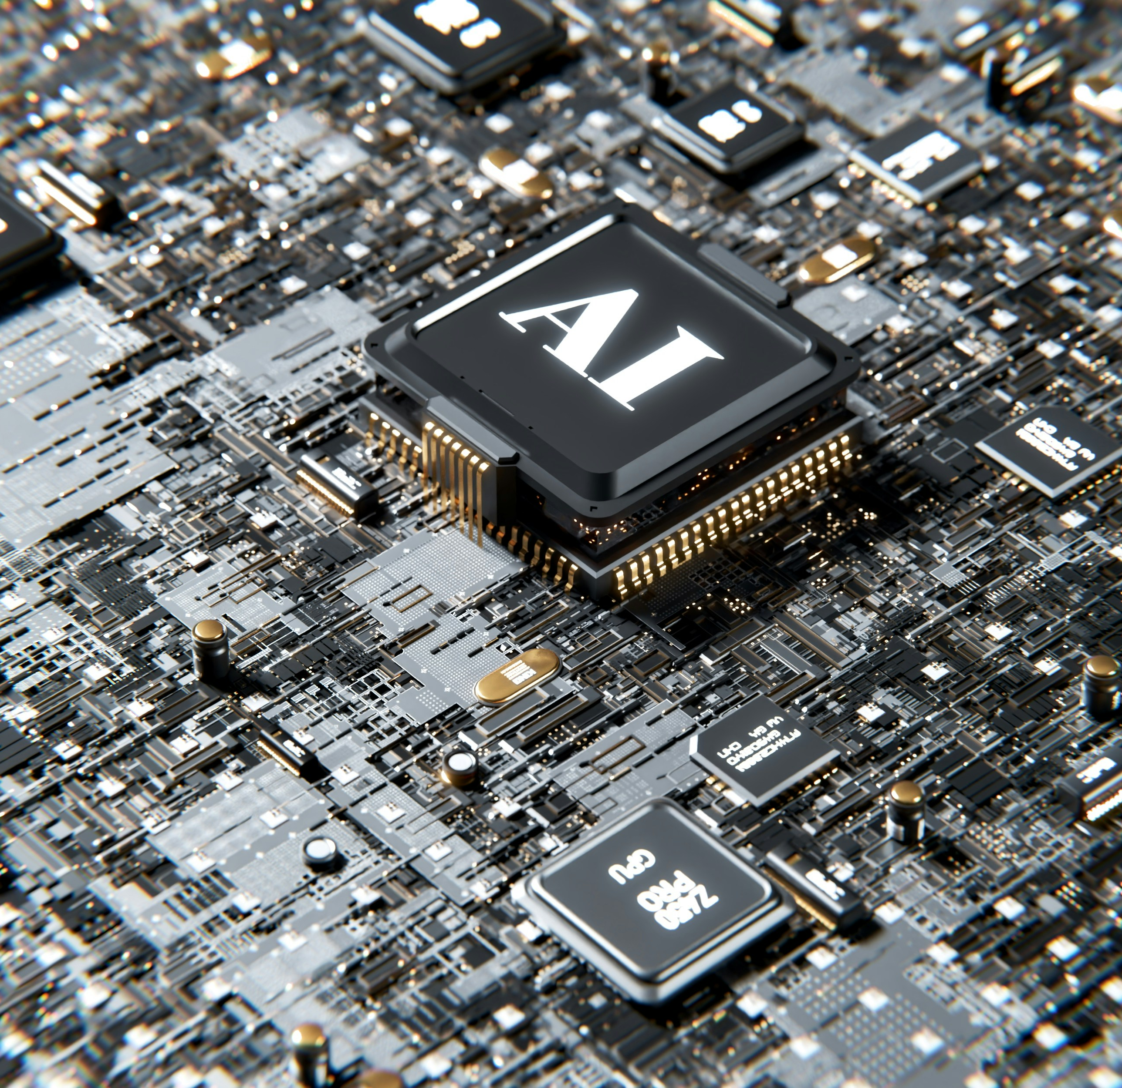
What is AI?
“AI” is a rather nebulous term, and has been used or misused to refer to many different algorithms over the years.
We often consider AI to be when tasks once the domain of the human are now carried out by a machine.
“Generative AI” is the field of AI currently experiencing rapid growth, buzz and, importantly, use by students.
Notes:
(1 minute)

Slide 4
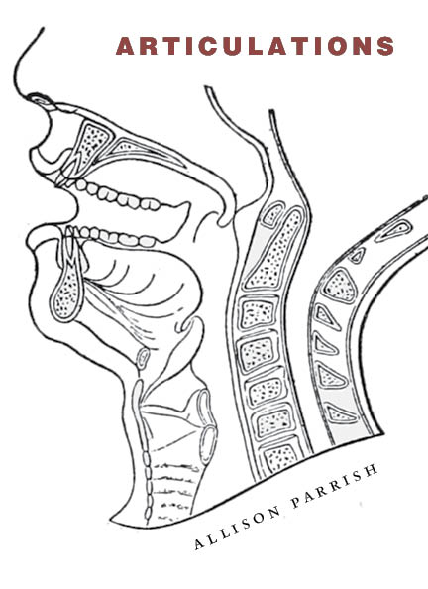
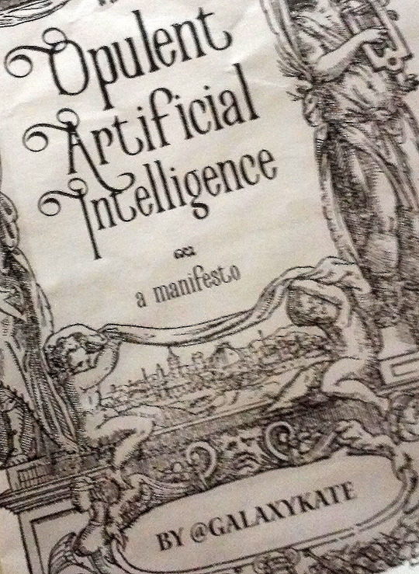
Why use AI?
GenAI can provide us with new and exciting possibilities, which we are only just scratching the surface of.
Over the last ~10 years, AI researchers and artists have explored how we can use AI not to mimic the human, but to do something altogether new.
GenAI tools like PI AI, ChatGPT, etc. have the potential to democratize these opportunities.
Notes:
(1 minute)

Slide 5
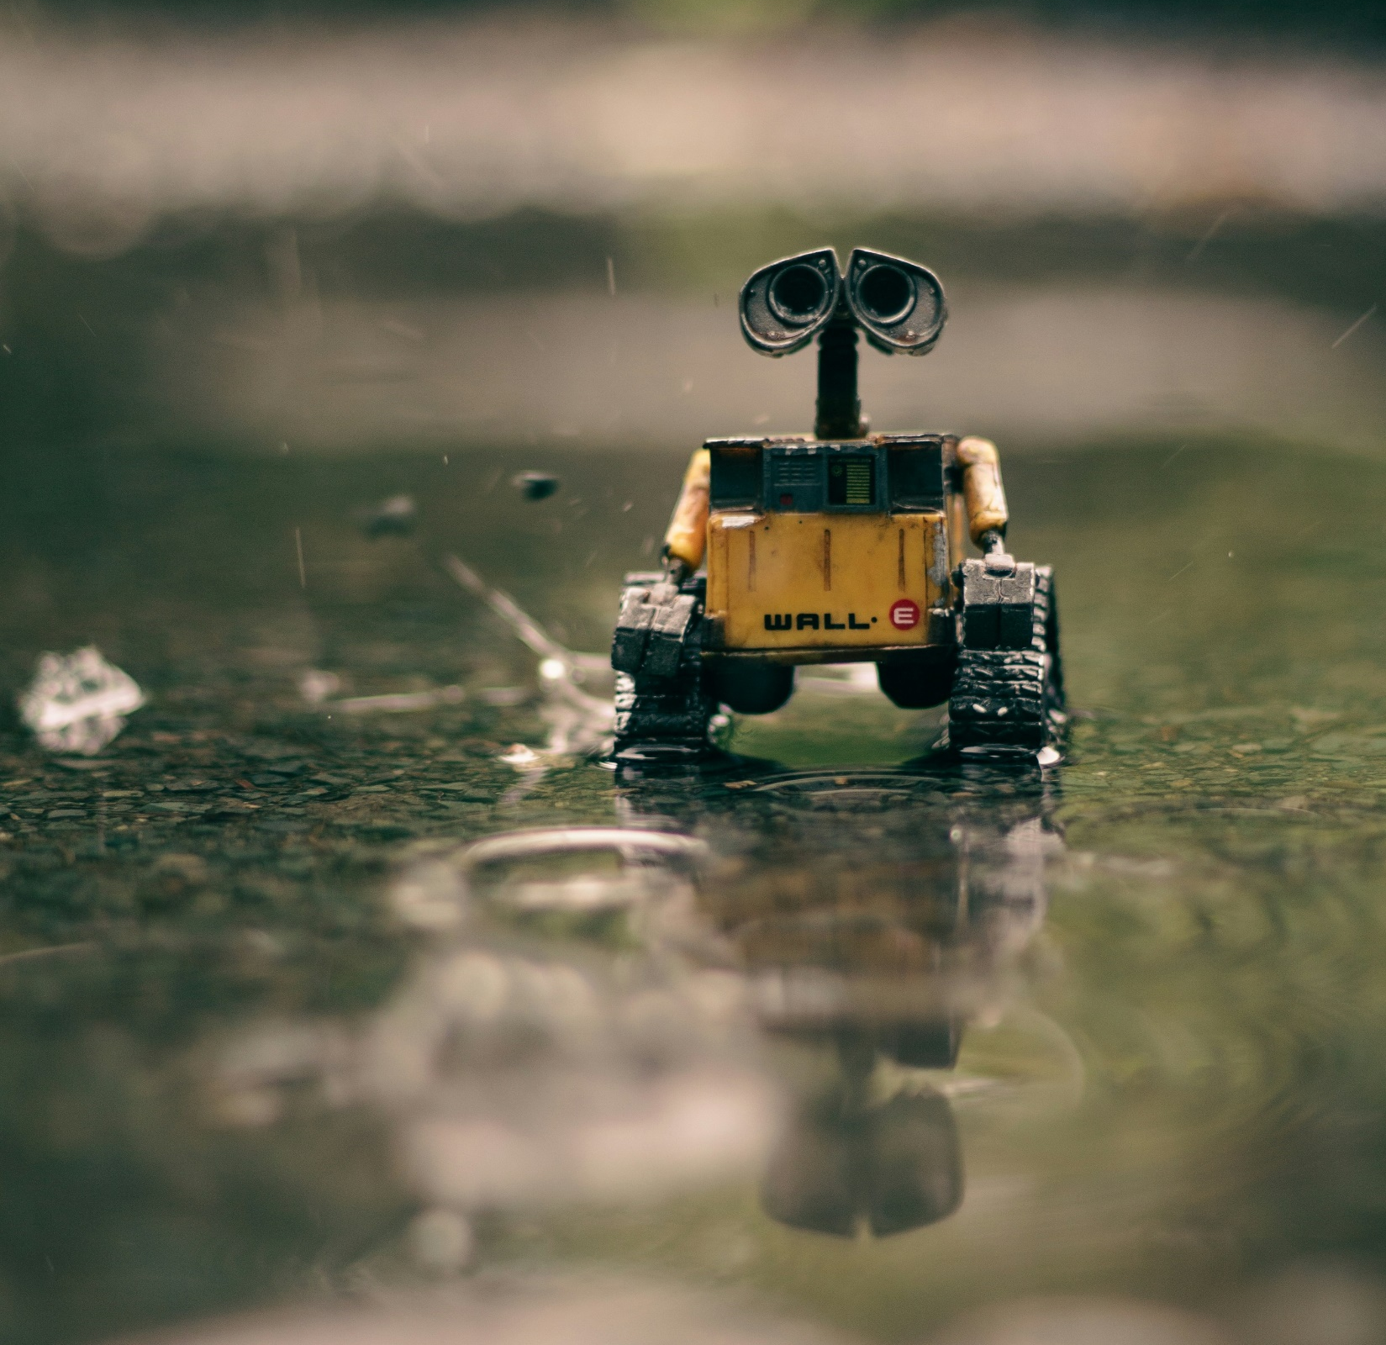
Our responsibilities
Although there is great opportunity, there are also a lot of ethical and sustainability concerns that come along with the use of GenAI.
As educators, it is our responsibility to be aware of these concerns and educate our students.
As STEM educators, it is our obligation.
Notes:
(2 minutes)

Slide 6
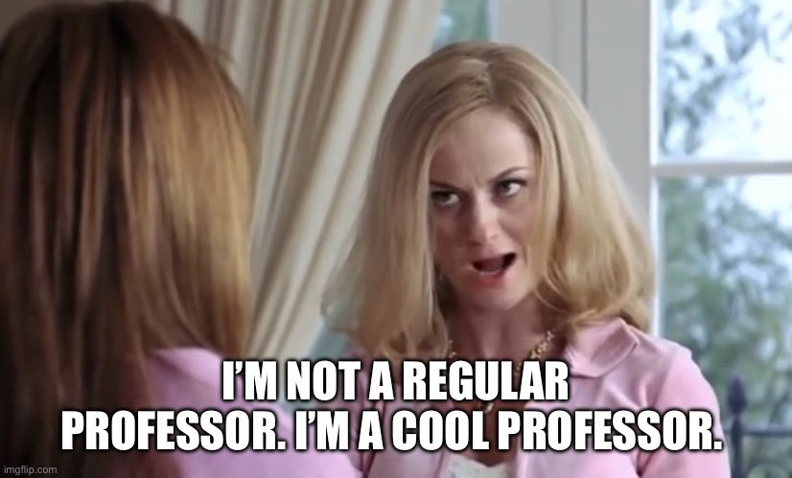
Being “GenAI positive”
Many of us have our own views on Generative AI, and some have taken very “open minded” positions.
We’re educators, and should be better than that.
Dismissively positive approaches to Generative AI and “letting students do what they want” is dangerous.
Image source: https://twitter.com/Benavidez_Gabe/status/1674519919076188161/photo/1
Notes:
(2 minutes)

Slide 7
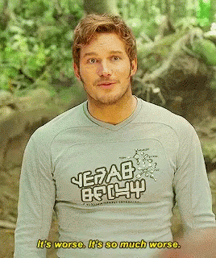
It’s not that bad though, right?
Trigger Warning: Abuse & Misogyny.
Notes:
(1 minute)

Slide 8
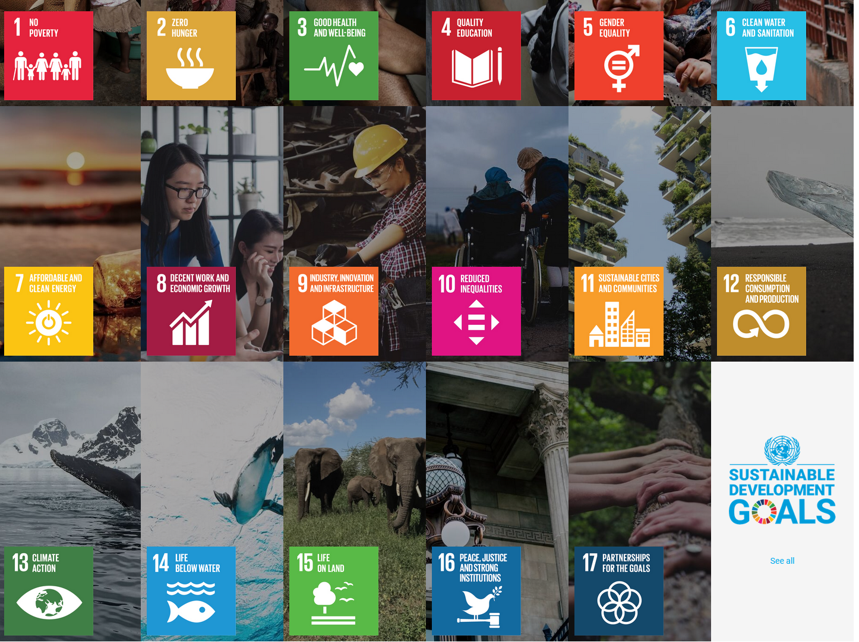
SDGs
Notes:
(1 minute)

Slide 9
SDGs
Notes:
(1 minute)

Slide 10
Quality Education
AI tools like ChatGPT are known to “hallucinate”, lie or otherwise be confidently incorrect. The text it generates actually fits the Academic definition of bullshit (Hicks et al. 2024). They shouldn’t be writing our lectures for us, that’s for sure.
However, is there something to be said for a student being able to ask a chatbot at 4am for advise on late submissions, so they get a good night’s sleep, even if the information isn’t totally correct?
Notes:
(2 minutes)

Slide 11
Equality
AI Researchers have long discussed the “embedded prejudice” in AI models, where they tend to promulgate the biases from within their training data (Bolukbasi et al. 2016). Using AI to generate images or case studies will likely contribute to these prejudices.
However, Generative AI can also be used by EAL/D students to improve written expression. It can also provide marginalized communities with resources, and offer support or information to vulnerable populations (Rane 2023, pp. 3-4).
Notes:
(2 minutes)

Slide 12
Well-being and exploitation
Image generation tools Stable Diffusion and MidJourney have been trained on a dataset containing child exploitation material (Thiel 2023). While it is unlikely these images will influence anything we might generate for our slides, the fact remains this content exists within the dataset.
We need to be aware of the tools we use, and can make informed decisions. As regulation of Generative AI increases, we can help promote the use of responsible Generative AI.
Notes:
(2 minutes)

Slide 13
Copyright, consent and industry
Generative AI models are often trained on an unregulated amount of copyrighted material, without the consent of the artists (Ho, 2024). Artists losing jobs to AI aside, how do we justify copyright infringement, especially as an Academic institute?
However, if we manage to solve these problems, generative AI can be used as a tool to improve creative workflow (Barth 2023), create quick mock-ups, etc.
Notes:
(2 minutes)

Slide 14
Oh, and another thing…
Feeding your unit materials, student data and other sensitive information into Generative AI you are accessing on the cloud is not a good idea.
This data then becomes part of the AI’s training data in many cases. It then becomes possible to retrieve that data.
We also don’t want our students doing this, either. So we should be careful about encouraging Generative AI use!
Notes:
(2 minutes)

Slide 15
Environmental Impact
The production and use of Generative AI models has been found to have considerable environmental impacts in terms of both carbon emissions and metal scarcity (Berthelot et al. 2024). Training of AI models also results in high water consumption (Li et al. 2023).
Generative AI can be used to help analyse data to detect water use patterns, waste management, and otherwise aid in conservation activities and more (Rane 2023, pp. 5-6).

Slide 16

However…
Technological determinism is not something we should subscribe to.
Many of these problems have solutions stemming from the long history of AI ethicists, artists and creators.
Notes:
(1 minute)

Slide 17

However…
As educators, we can help shape the future of AI through critical, responsible use and robust ethical practices.
I might sound a bit gloomy, but it’s important we have these conversations.
Let’s find the answers together.
Notes:
(1 minute)

Slide 18
References
Barth, R. (2023). The Convergence of AI and Creativity: Introducing Ghostwriter. Ubisoft News. https://news.ubisoft.com/en-us/article/7Cm07zbBGy4Xml6WgYi25d/the-convergence-of-ai-and-creativity-introducing-ghostwriter
Berthelot, A., Caron, E., Jay, M., & Lefèvre, L. (2024). Estimating the environmental impact of Generative-AI services using an LCA-based methodology. Procedia CIRP 122. https://doi.org/10.1016/j.procir.2024.01.098
Bolukbasi, T., Chang, K-W., Zou, J. Saligrama, V. & Kalai, A. (2016). Man is to Computer Programmer as Woman is to Homemaker? Debiasing Word Embeddings. Advances in Neural Information Processing Systems 29 (NIPS 2016). https://doi.org/10.48550/arXiv.1607.06520
Hicks, M.T., Humphries, J. & Slater, J. (2024). ChatGPT is bullshit. Ethics Inf Technol 26, 38. https://doi.org/10.1007/s10676-024-09775-5
Ho, K.K. (2024). Database of 16,000 Artists Used to Train Midjourney AI, Including 6-Year-Old Child, Garners Criticism. ARTNews. https://www.artnews.com/art-news/news/midjourney-ai-artists-database-1234691955
Li, P., Yang, J., Islam, MA. & Ren, S.(2023). Making AI Less "Thirsty": Uncovering and Addressing the Secret Water Footprint of AI Models. Pre-print. https://doi.org/10.48550/arXiv.2304.03271
Rane, N. (2023). Roles and challenges of ChatGPT and similar generative artificial intelligence for achieving the sustainable development goals (SDGs). Available at SSRN 4603244. http://dx.doi.org/10.2139/ssrn.4603244
Thiel, D. (2023). Identifying and Eliminating CSAM in Generative ML Training Data and Models. Stanford Digital Repository. https://doi.org/10.25740/kh752sm9123
Notes:
(1 minute)

